Slide 1
C++ Basic Syntax
The C++ Language, Data Types, Expressions, Loops and Functions

Slide 2
Table of Contents
History, Concepts & Philosophy, Standards
C++ Program Structure, Compiling & Running C++ Code
Primitive Data Types in C++
Declaring & Initializing Variables, Scope
Operators, Expressions, Conditionals, Loops
Functions
Basic Console I/O

Slide 3
What is C++
Fast, Mid-level, Multi-Platform, Multi-paradigm

Slide 4
What is C++?
General purpose programming language
Compiles to binary
Multi-platform, but underlying features may differ between systems
Statically typed – data in predefined forms (data types)
Multi-paradigm
Fast

Slide 5
C++ Philosophy
Features immediately useful in the real world
Programmers free to pick their own style
Useful features more important than preventing misuse
Features you do not use, you do not pay for
Programmer can specify undefined behavior
More: en.wikipedia.org/wiki/C++#Philosophy

Slide 6

C++ History
No, not this guy, sorry
Created 1979 – 1983 by Bjarne…

Slide 7

C++ History
This one. See, much better!
Psst! Hey, kids, want some Classes?
Created 1979 – 1983 by Bjarne…
… Stroustrup
Originally “C with Classes”

Slide 8
C++ Standards
C++ 98 – first standardized C++ version
Still massively used today
C++ 03 – minor revision of 98, bug-fixes
C++ 11 – major revision
Many new features and improvements
Initializer lists, Rvalue references, lambdas, range-based loops, etc.
C++ 14 – latest official revision
Small features and fixes
Binary literals, variable templates, more type deduction, etc.

Slide 9
C++ Compilers & IDEs
A C++ compiler turns C++ code to assembly
i.e. translates C++ to machine language
An IDE is software assisting programming
Has a Compiler, Linker, Debugger, Code Editor
Code organization, Tools, Diagnostics
There are lots of C++ compilers and IDEs
Free, open-source, proprietary

Slide 10
Code::Blocks
Free C & C++ IDE
Comes with MinGW GCC compiler
C++11 support needs to be enabled from settings
C++14 support needs more complicated setting to enable
Lightweight
Can compile single .cpp file
Can be used for bigger projects with many files, references, etc.
We will start the with Code::Blocks and show other IDEs later

Slide 11
C++ Program Structure, Compiling & Running C++
Entry point, Compilers & IDEs

Slide 12
Hello World
Say we’re working with std namespace (so we don’t write std:: in front of everything)
Include the input-output library
Here’s a classic C++ “Hello World” example
Parameters in these brackets are optional
1 #include <iostream>
2 using namespace std;
3
4 int main(int argc, char * argv[]) {
5 cout << "Hello World!" << endl;
6 return 0;
7 }
Print to the console
"main" function – our entry point
For main, 0 means everything went ok, terminating normally

Slide 13
C++ Entry Point & Termination
The main function – entry point of the program
No other function can be named "main"
C++ needs specific function to start from
Everything else is free-form – code ordering, namings, etc.
Can receive command line parameters
Termination – main finishes (returns), the program stops
The return value of main is the "exit code“
0 means no errors – informative, not obligatory

Slide 14
Program Structure: Including Libraries
C++ has a lot of functionality in its standard code libraries
C++ can also use functionality from user-built code libraries
Say what libraries to use with the #include syntax
For now, for standard libraries: put the library name in <>
1 #include <iostream>
2 using namespace std;
3
4 int main(int argc, char * argv[]) {
iostream contains console I/O functionality

Slide 15
Program Structure: Blocks
Basic building block (pun intended) of a program
Most actual program code is in blocks, aka “bodies”
Start with { and end with }, can be nested
Functions’ (like main()), loops’ & conditionals’ code is in blocks
int main(int argc, char * argv[])
{
5 cout << "Hello World!" << endl;
6 return 0;
7 }
main() code block

Slide 16
Program Structure: Statements & Comments
Statement: a piece of code to be executed
Blocks consist of statements
Statements contain C++ code and end with a ;
C++ has comments (parts of the code ignored by compiler)
// comments out an entire line, /* starts a multi-line comment, */ ends it
A statement
int main(int argc, char * argv[])
{
5 cout << "Hello World!" << endl;
6 return 0;
7 }
Another statement (Note: usually 1 per line)

Slide 17
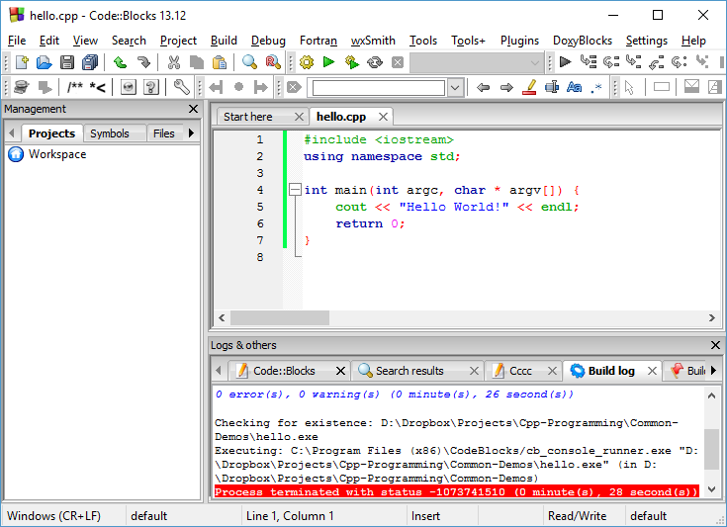
C++ Hello World
Live Demo

Slide 18
Variables & Primitive Types
Integers, Floating-Point, Characters, Variable Declaration, Initialization, Scope

Slide 19
Fast Intro: Declaring and Initializing Variables
<data_type> <identifier> [= <initialization>];
Declaring: int num;
Initializing: num = 5;
Combined: int num = 5, and additionally int num(5);
Can declare multiple of same type by separating with comma (,)
int trappist1BMassPct=85, trappist1CMassPct=80; is valid
NOTE: int num() is not a default initialization – it’s a function declaration.
int numGlobal;
int main() {
int num;
num = 5;
int sameNum(5);
return 0;
}

Slide 20
Declaring & Initializing Variables
Live Demo

Slide 21
Quick Quiz:
TIME’S UP!
TIME:
Tony gives George 5 apples
Later, Angus gives George 3 apples
How many apples does George have?

Slide 22
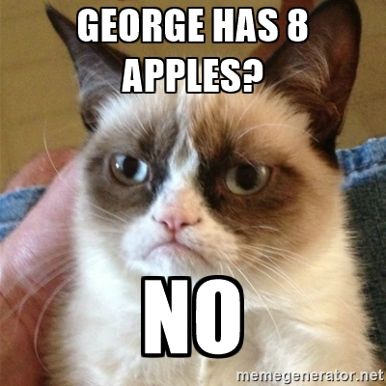
C++ Pitfall: UnInitializED Locals
George has 13837 apples.
Why?
Nobody said George had 0 apples to begin with.

Slide 23
Uninitialized Locals
Live Demo

Slide 24
Local & Global Variables
Global: defined outside blocks, usable from all code
Local: defined inside blocks, usable only from code in their block
Locals DO NOT get initialized automatically
Globals get initialized to their “default” value (0 for numerics)
int secondsInMinute = 60;
int minutesInHour = 60;
int hoursInDay = 24;
int secondsInHour = secondsInMinute * minutesInHour;
int main() {
int days = 3;
int totalSeconds = days * hoursInDay * secondsInHour;

Slide 25
Global & Local Variables
Live Demo

Slide 26
const Variables
C++ supports constants – “variables” that can’t change value
Can and MUST receive a value at initialization, nowhere else
Can be local, can be global
secondsInMinute, minutesInHour, etc., aren’t things that normally change in the real world – the following won’t compile:
NOTE: the const keyword has other uses which we’ll discuss later on
const int secondsInMinute = 60;
int main() {
secondsInMinute = 13; //compilation error

Slide 27
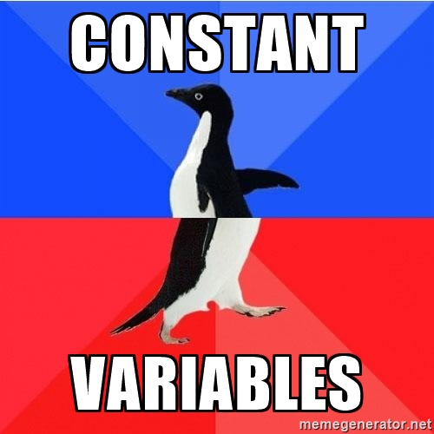
const Variables
Live Demo
Yes, I know that’s not how that meme’s used. Shut up.

Slide 28
Other variable modifiers
static variables initialize once and exist throughout program
Can be used to make a local variable that acts like a global one
Can be global, but that’s basically the same as a normal global variable
We’ll talk more about them later
extern tells the compiler a variable exists somewhere in a multi-file project
Will discuss this in another lecture
register is a hint to compiler where to store the variable
Mostly redundant these days

Slide 29
Primitive Data Types
Representing Integer, Floating-point and Symbolic values

Slide 30
Integer Types – int
C++ has “only one” integer type – int
“Width” modifiers control the type’s size and sign
short – at least 16 bits; long – at least 32 bits
long long – 64 bits (C++11, Windows supports it on C++03 too)
signed and unsigned control whether memory used for sign data
Modifiers can be written in any order
int can be omitted if any modifier is present
Defaults: int “usually” means signed long int

Slide 31
Integer Sizes and Ranges
The C++ standard doesn’t have very strict size guarantees
Depends on implementation, but int is 32-bits on most mainstream PCs
Use the sizeof(int) operator to get the size (in bytes) on your system
Ranges depend on size, a 32-bit integer has about 4 billion values
So, a signed 32-bit integer has the range of about (-2 billion, +2 billion)
Average human lifespan is about 2 billion seconds. int is older than you!
Sizes: http://en.cppreference.com/w/cpp/language/types#Properties
Ranges: http://en.cppreference.com/w/cpp/language/types#Range_of_values

Slide 32
Integer Types
Live Demo

Slide 33
Floating-Point Types
Represent real numbers (approximations)
2.3, 0.7, -Infinity, -1452342.2313, NaN, etc.
float: single-precision floating point, usually IEEE-754 32-bit
double: double-precision floating point, usually IEEE-754 64-bit
Name | Description | Size* | Range*
float | Floating point number. | 4bytes | ±1.5 × 10⁻⁴⁵ to ±3.4 × 10³⁸ (~7 digits)
double | Double precision floating point number. | 8bytes | ±5.0 × 10⁻³²⁴ to ±1.7 × 10³⁰⁸ (~15 digits)
long double | Long double precision floating point number. | 8bytes | ±5.0 × 10⁻³²⁴ to ±1.7 × 10³⁰⁸ (~15 digits)

Slide 34
Using Floating-Point Types
Live Demo

Slide 35
Guaranteeing Type Sizes
C++ has some tentative cross-platform support for fixed-size types
There is the C++11 bitset, the cstdint library, etc.
Code running on most systems has access to system macros
E.g. on Windows: INT32, INT8, FLOAT, INT_PTR, LONG_PTR
If you know the system, you can use those macros to guarantee size
Universally-portable code with fixed type sizes is not really possible
Do you really expect a toaster to guarantee a 64-bit integer?
In most cases, type-size guarantees are not necessary

Slide 36

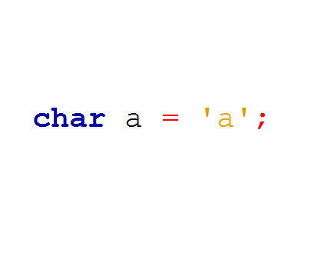
char
No, Not This Char
The C++ Character Type

Slide 37
Character Types – char
char is the basic character type in C++
Basically an integer interpreted as a symbol from ASCII
Guaranteed to be 1 byte – a range of 256 values
Initialized by either a character literal or a number (ASCII code)
int main() {
char letter = 'a';
char sameLetter = 97;
char sameLetterAgain = 'b' - 1;
cout << letter << sameLetter << sameLetterAgain << endl;
return 0;
}

Slide 38
Using char as a Number
char is essentially a 1-byte integer, it can be used as such
char is also useful when processing data byte-by-byte
Always use signed or unsigned when using char as a number
Guarantees the range of char as [-128, 127] or [0, 255] respectively
Otherwise the system picks whatever it thinks is best for character representation
… you don’t want the system pretending to be smart
Avoid using char as a number unless you have a good reason to

Slide 39
Using Character Types
Live Demo

Slide 40
Boolean Type – bool
bool – a value which is either true or false, takes up 1 byte
Takes true, false, or numeric values
Any non-zero numeric value is interpreted as true
Zero is interpreted as false
int main() {
bool initializedWithKeyword = true;
bool initializedWithKeywordCtor(false);
bool initializedWithZero = 0;
bool initializedWithNegativeNumber(-13);

Slide 41
Using bool
Live Demo

Slide 42
Rules for C++ Identifiers
We’ve been declaring variables using some rules
Variable names are a type of identifier
Data types, functions, classes, etc. are identifiers
Allowed symbols: alphabetic characters, digits, underscores
Can’t begin with a digit
Case-sensitive
Can’t be a reserved C++ keyword (like int, return, true, etc.)

Slide 43
Implicit & Explicit Casting
Types which “fit” into others can be assigned to them implicitly
For integer types, “fit” usually means requiring less bytes
E.g. char a = ‘a’; int i = a; is a valid operation
But int i = 97; char a = i; is not
For floating point, float fits into double
If you really want to store a “bigger” type in a “smaller” type:
Explicitly cast the “bigger” type to the “smaller” type: smallType smallVar = (smallType) bigVar;
Can lose accuracy if value can’t be represented in “smaller” type

Slide 44
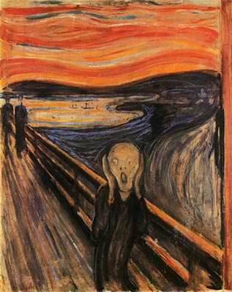

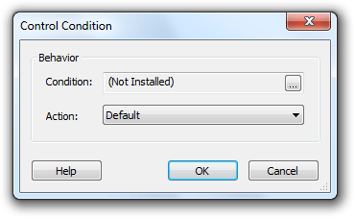

Expressions, Operators, Conditionals, Loops,
Literals, If, switch, else, for, while,

Slide 45
C++ Literals
Represent values in code, match the primitive data types
Integer literals
Value in a numeral system – decimal, octal, hex, and binary (C++11)
Suffix to describe sign and width (like the int modifiers)
Floating-point literals
Digit sequence decimal OR exponential notation
Suffix to describe precision (single or double-precision)

Slide 46
C++ Non-Numeric Literals
Character literals – letters surrounded by apostrophe (‘)
String literals – a sequence of letters surrounded by quotes (“)
That’s what we used to print Hello World!
Boolean literals – true and false

Slide 47
C++ Literals – Things to Keep in Mind
Integers are positive – writing a - does a minus operation
Integers should be suffixed if they are too large for a simple int
Compiler might try to extend automatically, but don’t rely on it
Floating-points are double by default, suffix with f for float
Note: there are also string literals – discussed in another lecture
#include<iostream>
using namespace std;
int main() {
cout << -42 << " " << 052 << " " << 0x2a << " " << 0x2A << endl
<< 0.42 << " " << .42f << " " << 42e-2 << endl;
}

Slide 48
C++ Literals
Live Demo

Slide 49
Expressions and Operators
C++ operators and expressions are similar to other languages’
Operators:
Perform actions on one or more variables/literals
Can be customized for different behavior based on data type
C++ operator precedence and associativity table: http://en.cppreference.com/w/cpp/language/operator_precedence
Don’t memorize. Use brackets and look up precedence when necessary
Expressions: literals/variables combined with operators/functions

Slide 50
Commonly Used C++ Operators
Category | Operators
Arithmetic | + | - | * | / | % | ++ | --
Logical | && | || | ^ | !
Binary | & | | | ^ | ~ | << | >>
Comparison | == | != | < | > | <= | >=
Assignment | = | += | -= | *= | /= | %= | &= | |= | ^= | <<= | >>=
String concatenation | +
Other | . | [] | () | a?b:c | new | delete | * | -> | :: | (type) | << | >>

Slide 51
C++ Operators & Expressions
Live Demo

Slide 52
Conditionals
C++ supports if-else and switch-case for code branching
The if-else statement takes in a Boolean expression
If the expression evaluates to true, the if block is executed
If the expression evaluates to false, the else block is executed
The else block is optional
Block { } brackets can be omitted if only 1 statement (not recommended)
double value1 = 5 * 5 / 2.f, value2 = 5 * 5 / 2;
if (value1 > value2) {
cout << "value1 is larger" << endl;
} else {
cout << "value2 is larger" << endl;
}

Slide 53
“Chaining” if-else
Can “chain” several checks one after the other
The code below is equivalent. Each else block contains 1 “If” statement, so they don’t need brackets. The left variant skips the brackets
if (value1 > value2) {
cout << "value1 is larger";
} else if (value1 == value2) {
cout << "values are equal";
} else {
cout << "value2 is larger";
}
if (value1 > value2) {
cout << "value1 is larger";
} else {
if (value1 == value2) {
cout << "values are equal";
} else {
cout << "value2 is larger";
}
}

Slide 54
Quick Quiz
TIME’S UP!
TIME:
What will this code print out to the console?
#include<iostream>
using namespace std;
int main() {
int a = 5;
int aMod3 = a % 3;
if (a = aMod3) {
cout << "equal" << endl;
} else {
cout << "not equal" << endl;
}
return 0;
}

Slide 55
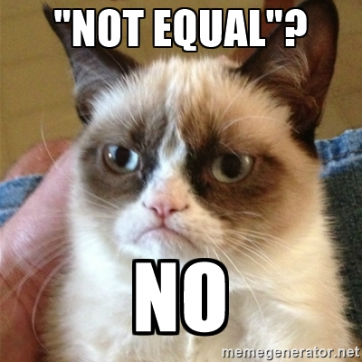
C++ Pitfall: Assignment instead of comparison in conditional
Check the code again.
The expression in the if is not the == check, it is the = assignment,
Which here is non-zero, evaluates to true, so we go in the if block

Slide 56
if and if-else
Live Demo

Slide 57
switch-case
Example of C++ switch-case usage
switch (day)
{
case 1: cout << "Monday"; break;
case 2: cout << "Tuesday"; break;
case 3: cout << "Wednesday"; break;
case 4: cout << "Thursday"; break;
case 5: cout << "Friday"; break;
case 6: cout << "Saturday"; break;
case 7: cout << "Sunday"; break;
default: cout << "Error!"; break;
}

Slide 58
switch-case structure
The C++ switch statement takes in
An integer expression OR an enumeration type (we’ll discuss enums later)
OR something which implicitly converts to an int (like char)
The case block can contain case labels and any other code
Each label has an expression of the same type as the switch
The case block can also contain the break statement
If reached, code continues from after the case block
There is a special default label (without an expression)

Slide 59
switch-case execution
The switch evaluates the expression and finds the matching case
Matching means the value of the case matches the value of the switch
Any code before the matching case is skipped
Any code after the matching case is executed
Until break or the end of the block is reached
Note: this means other case labels may be executed after the matching one!
If there is no matching case
If the block contains the special default label, it is executed
Otherwise the case block is skipped

Slide 60
switch-case
Live Demo

Slide 61
Loops
C++ has the 3 common types of loops – for, while and do-while
Each loop consists of a loop condition and a loop block (body)
1-statement blocks don’t need { }
Basically the same syntax as if-else
C++ loop control keywords:
break – interrupts the loop and continues after its block
continue – the current iteration skips the remaining part of the loop block
C++11 also added a range-based for loop
We’ll discuss it in the lecture on arrays & pointers

Slide 62
for Loop
Syntax: for([init]; [condition]; [increment]) {body code;}
The init statement can declare and initialize variables
Declared variables are usable only IN the for’s body, but usually initializes the loop’s control variable
The loop runs while the condition statement evaluates to true
The increment statement is executed AFTER the for’s body
Usually increments the loop’s variable, but can execute any expression
init and increment expressions are separated by comma (,)

Slide 63

Fibonacci with “Empty” for Loop
Every time you do something like this, a kitty dies
int currentNum = 1;
for(int i = 2, lastNum = 1, newCurrent;
i < fibonacciToCalculate;
i++, newCurrent = lastNum + currentNum,
lastNum = currentNum, currentNum = newCurrent) {
}
cout << currentNum << endl;

Slide 64
for Loop
Live Demo

Slide 65
while Loops
while syntax: while (condition) { body code; }
Executes body until condition becomes false
Body may never execute
do-while syntax: do { body code; } while (condition);
First executes body, then checks condition
Guaranteed to execute at least once
int age = 0;
while (age < 18) {
cout << "can't drink at age " << age << endl;
age++;
}
cout << "age " << age << ", can finally drink!" << endl;

Slide 66
while Loops
Live Demo

Slide 67
Functions
Defining, Implementing, Calling, Overloading

Slide 68
What is a Function?
A kind of building block that performs a specific task
A named block of code, which can be called from other code
Can take parameters and return a value
Similar to math functions like cos(α), sin(α), tan(α), etc.
All of these are actually functions you can use in C++
Allow programmers to construct large programs from simple pieces
Also known as methods, procedures, subroutines
main() is also a function, remember?

Slide 69
Calling Functions
Using functions is almost like using variables, however:
You don’t assign them values (imagine they are constants)
You write () after them, which could contain parameters
void functions just do something – you can’t use their “values”
Most functions return a value – you can use it in an expression
#include<iostream>
#include<cmath>
using namespace std;
int main() {
double degrees = 60;
double radians = degrees * M_PI / 180.0;
cout << sin(radians) << endl;
cout << cos(radians) << endl;
}

Slide 70
Calling Functions
Live Demo

Slide 71
Declaring and Defining Basic Functions with C++
Declare the function return type, its name and parameters
Define the body
always in a block
contains the actual function code
Call them same as you call other functions
#include<iostream>
int getMax(int a, int b) {
int maxValue;
if (a > b) {
maxValue = a;
} else {
maxValue = b;
}
return maxValue;
}
int main() {
std::cout << getMax(5, 7) << std::endl;
return 0;
}

Slide 72
Declaring & Defining Functions
Live Demo

Slide 73
Function Declaration
Syntax: returnType functionName(parameters)
The return type can be any C++ data type, or void
The function name follows the identifier rules (like variables)
Parameters: empty, single, or several separated by (,)
Parameter syntax:
dataType parameterName [= defaultValue]
If only declaring, parameter name is also optional

Slide 74
Function Declaration vs. Definition
Can be declared without being defined (given a code block)
Declaration can happen anywhere and happen multiple times
Global scope, blocks of code in other functions, etc.
Declaration visibility follows same rules as variable visibility
Useful for code organization (we’ll discuss in later lectures)
A function could be declared but not defined anywhere
If some code calls it, an error will happen at compilation

Slide 75
Parameters and Return Value
Parameters are just variables living in the function’s block
Parameters with default values:
Can be omitted by the caller
If omitted are initialized with the default value
Must be last in the parameter list
return immediately exits the function
Non-void functions must have a return
Non-void functions follow up return with a value to give back to the caller

Slide 76
Parameters and Return Value
Live Demo

Slide 77
Overloaded Functions
Same function name and return type, different parameter list
Different number or types of parameters
Indicate same operation can be done on different data
Overloaded functions often defer to each-other
int getMax(int a, int b) {
if (a > b) {
return a;
}
return b;
}
int getMax(int a, int b, int c) {
return getMax(a, getMax(b, c));
}

Slide 78
Parameters and Return Value
Live Demo

Slide 79
static Variables Inside Functions
Remember the static keyword?
Variable lives through entire program, even if declared locally
Initialized only once
static variables can be used inside functions to track state
E.g. how many times a function was called
double movingAverage(int nextNumber) {
static int numbers = 0;
static int total = 0;
total += nextNumber;
numbers++;
return total / (double)numbers;
}

Slide 80
static Variables Inside Functions
Live Demo

Slide 81
Basic Console I/O
Writing to & Reading from Console Using I/O Streams

Slide 82
C++ Streams
Things (classes) that either read or write data piece by piece
Example: we’ve been using cout throughout this lecture
Writes data to the console (standard output)
cout has a counterpart – cin
Reads data from the console (standard input)
#include<iostream>
using namespace std;
int main() {
int a, b;
cin >> a >> b;
cout << a + b << endl;
return 0;
}

Slide 83
Streams – Reading from & Writing to
Streams overload the << and >> operators
Left-hand side operand is the stream
Right-hand side operand is the data
Notice the direction of << and >>
stream << variable; - the variable (data) goes into the stream
stream >> variable; - the stream goes into the variable
Streams use the data type of the variable:
<< : To decide how to write it
>> : To know how much to read and how to save it into the variable

Slide 84
Chaining << and >> operators
Stream << and >> are still operators, so they must return a value
A reference to the stream is obtained each time you use << or >>
Basically, the result the operation is the stream itself
So, doing cin >> value gives you cin, on which you use >> again
That’s why cin >> value >> otherValue works, same for cout

Slide 85
Basic Stream Reading and Writing
Live Demo

Slide 86
Reading (Multiple) Numeric Values with cin
Expects console data to mostly match variable type literals
Expects input data to be separated by one or more spaces/lines
For integer types, a sequence of digits is expected
Can have sign, can NOT have type suffix (like L, ULL, etc.)
For floating-point types:
Can be an integer
Can be a sequence of digits separated by “.”
Can be exponential notation (e.g. 0.42e+2 will be read as 42)

Slide 87
Reading Multiple Numbers
Live Demo

Slide 88
Details on cin
cin is defined in the <iostream> library
Console input is sent when you press enter, not while you type
If cin can’t read the input it goes into a fail state
Input remains on the stream
cin used as a Boolean – returns if not in fail state
cin.getline() can be used to read an entire input line directly
We will discuss advanced console input in a following lecture

Slide 89
Details on cout
The endl we’ve been using so far with cout:
Represents the system’s newline symbol(s)
E.g. for Windows – “\r\n”, for Unix – “\n”
setprecision: how many digits to use for printing floating-points
Start count after or before the dot: depends on if we have fixed or not
fixed: floating-point digits should be counted after the dot
You can unset it using cout.unsetf(ios_base::fixed)
When not set, all digits are counted

Slide 90
Summary
We talked about
Integer & Other types, Initialization details, Scope, Expressions
Language capabilities like if-else, switch, loops and their specifics
Functions and how to declare and define them in C++
Next time
Arrays and their variants and usage in C++
References, Pointers and Basic memory management
Strings & Streams (advanced I/O)

Slide 91
Questions?

